Slide 1



AI-DRIVEN JOB INTERVIEW ANALYZER
Short Title: Interview Den (S25-47-D)
Team: Hamza Saeed 21i-0671
Waleed Saeed 21i-1672
Asad Ullah Shah 21i-0545
Supervisor: Dr. Mehreen Alam

Slide 2
Project Focus
The AI-Driven Job Interview Analyzer aims to automate and optimize the hiring process by leveraging AI.
Our Goal
AI Resume Screening
AI Test Creation
AI Interview
AI based Scoring and Insights
Recap

Slide 3
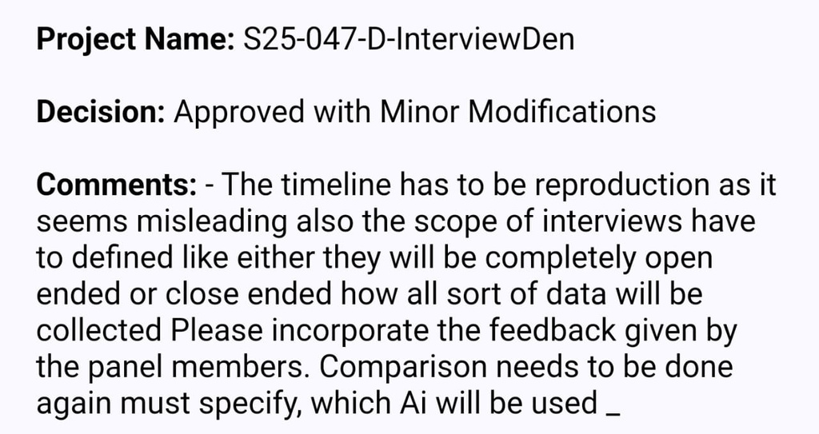
Feedback
Timeline: Next Slide
Comparison: Next Slide
Scope of Interviews: Open and Closed Ended Questions
AI Used: Grok LLM API

Slide 4
Iteration 2
APR-MAY
Develop company-side test creation portal:
- Model Training
- Multiple choice question system
- Text-based question interface
- Question bank management
- Test difficulty settings
Implement test scoring system
Create basic analytics dashboard for companies
Iteration 4
NOV - DEC
Integrate all components into a seamless workflow
Implement detailed reporting system:
- Candidate performance analytics
- Interview insights
- Skill assessment reports
Final testing and optimization
Documentation and deployment preparation
Timeline
Iteration 1
JAN-MAR
Set up project infrastructure and basic architecture
Develop basic login/signup
Create company and candidate portals (Figma)
Implement core resume screening AI:
- Resume parsing system
- Basic job description matching
- Initial CV analysis algorithms
Unit testing, Poster making
Iteraton 3
SEP-OCT
Develop AI-powered interview system:
- Voice-based question handling
- Natural language processing for responses
- Technical assessment modules
- Communication skills evaluation
Implement real-time interview feedback
Create comprehensive candidate evaluation system

Slide 5
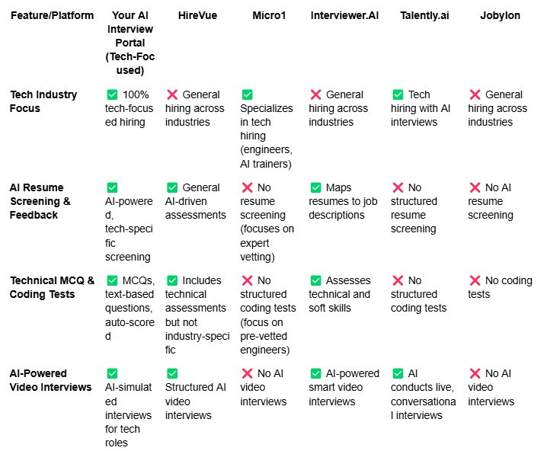
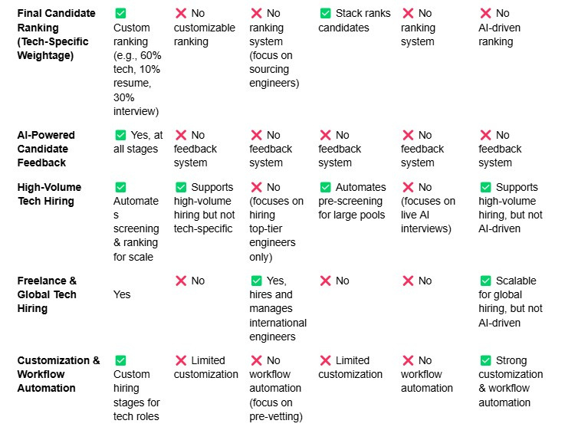
Competitors

Slide 6
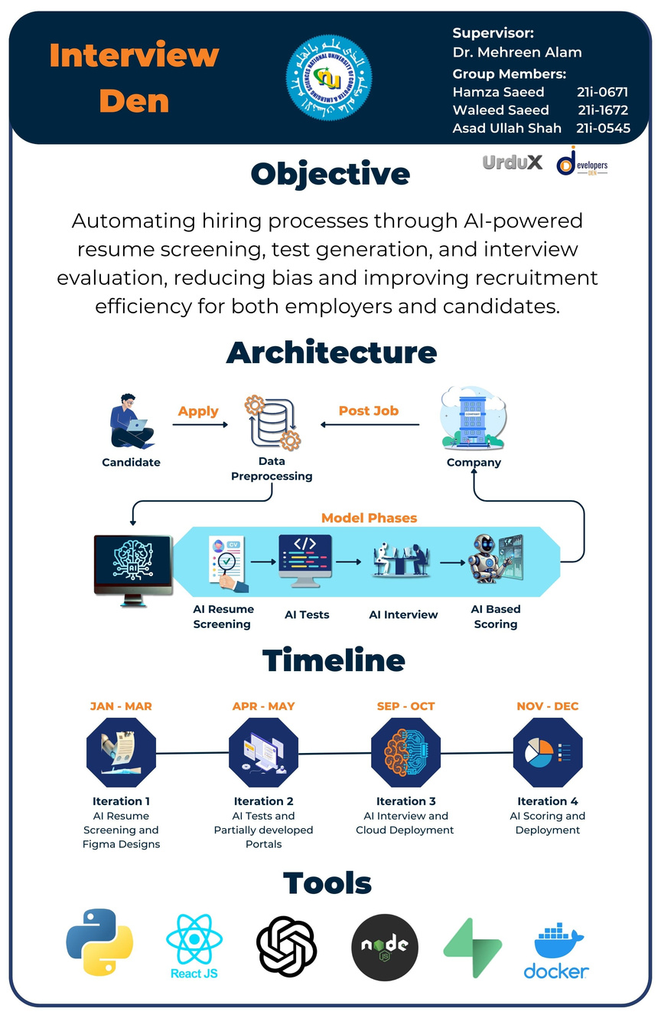
Poster

Slide 7
AI Resume Screening
AI Test Creation
AI Interview
AI Scoring and Analytics
Integration
Modules

Slide 8
This Module
1. AI Resume Screening
Resume Parsing Engine
Job-Resume Matching System
Fraud Detection System
Resume Recommendation Engine
2. Figma Designs
3. Working Frontend

Slide 9
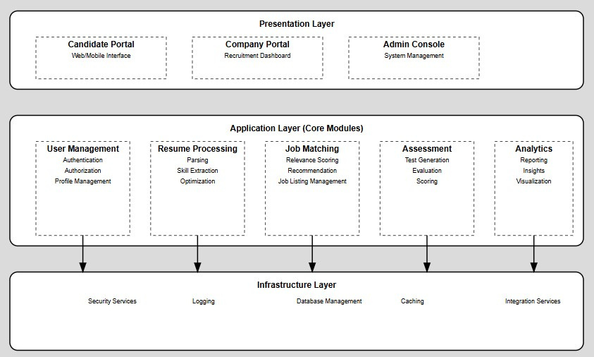
System Architecture

Slide 10
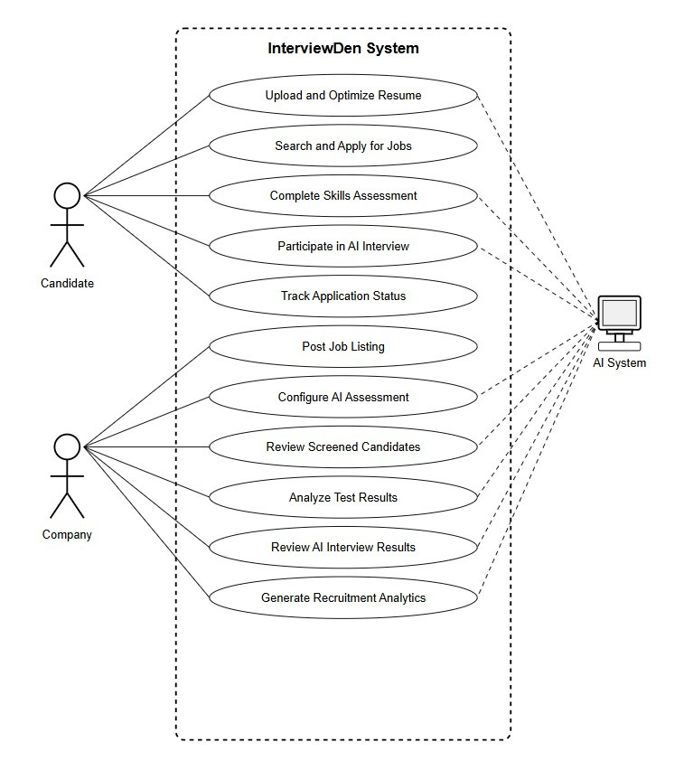
Use Case Diagram

Slide 11
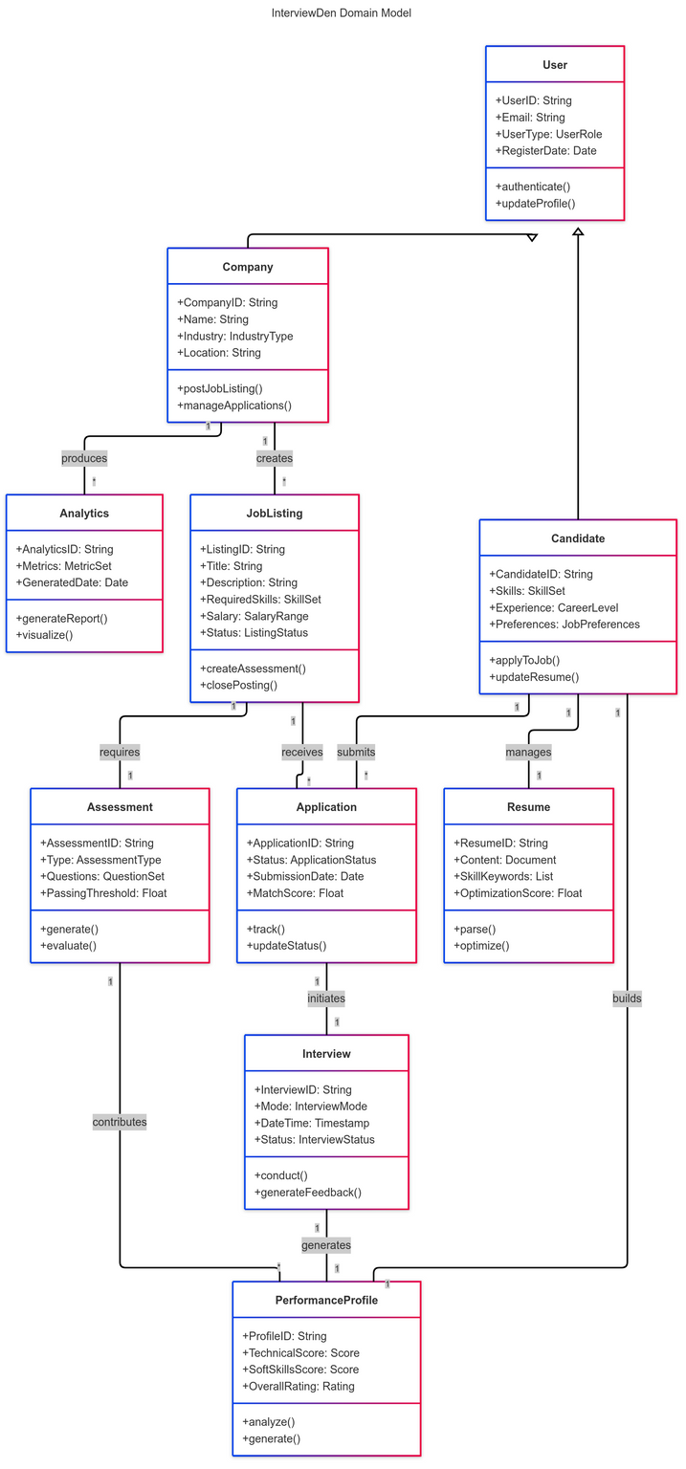
Domain Model Diagram

Slide 12
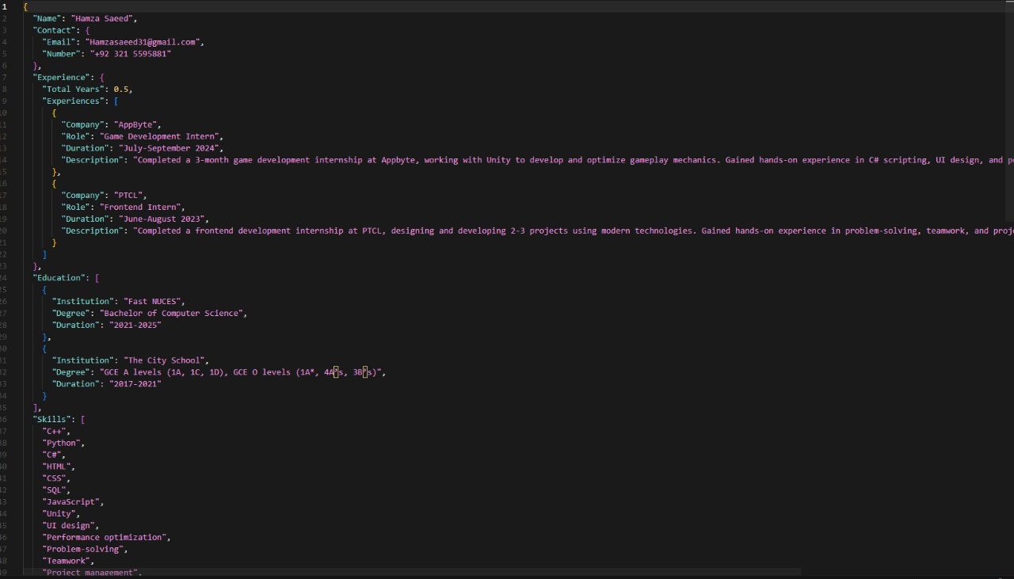
Resume Parsing

Slide 13
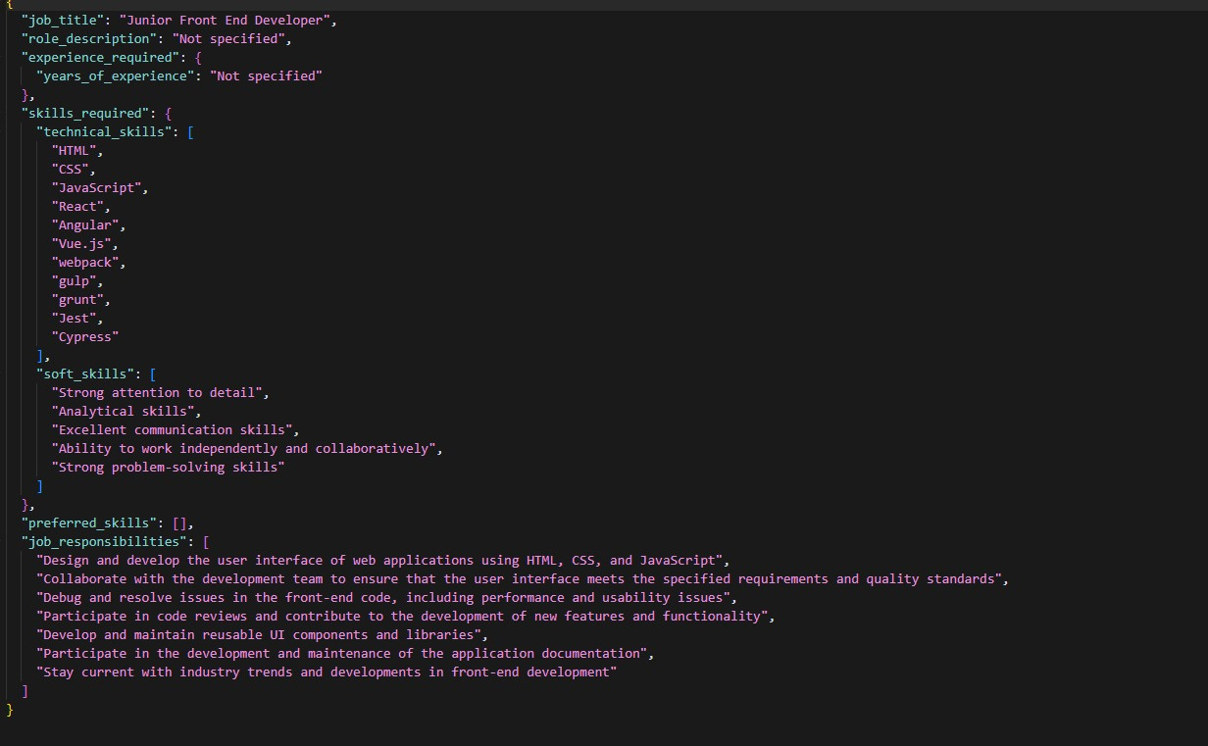
Job Description JSON

Slide 14
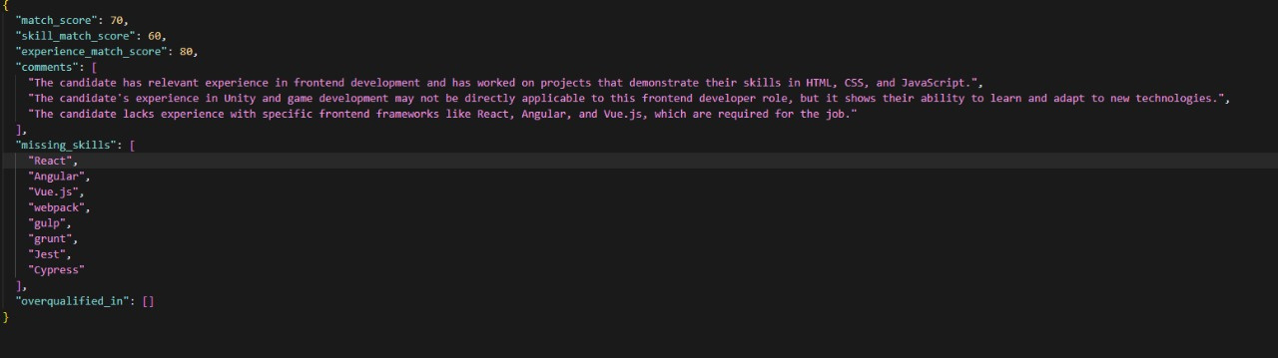
Model Output

Slide 15
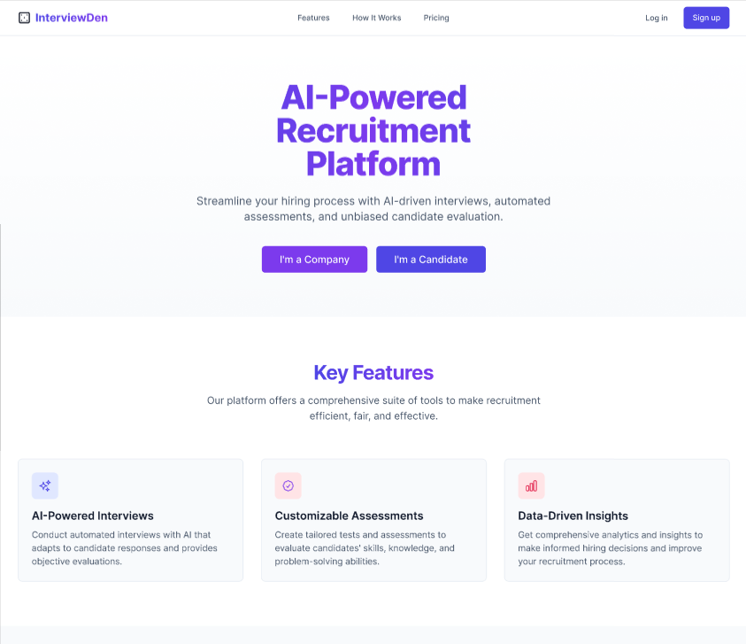
Figma Designs

Slide 16
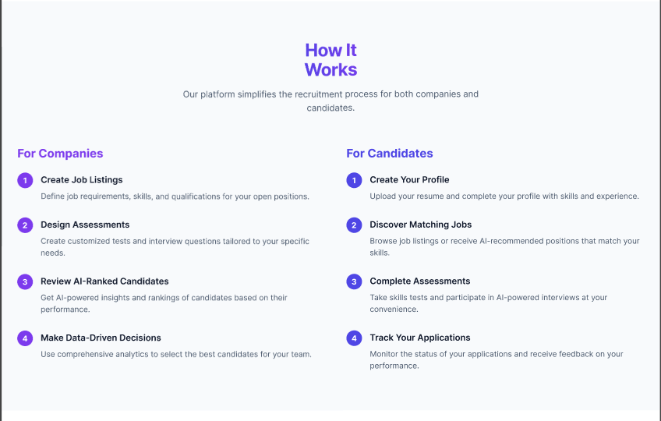

Slide 17
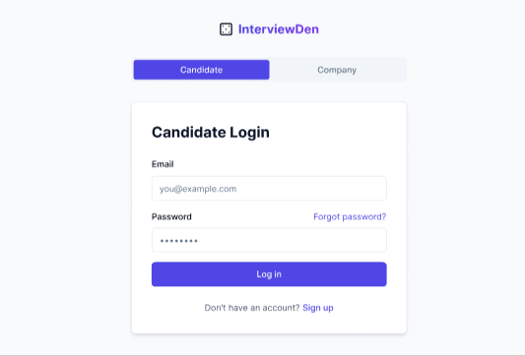
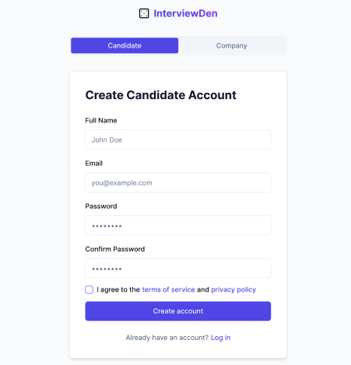
Login and Sign up

Slide 18
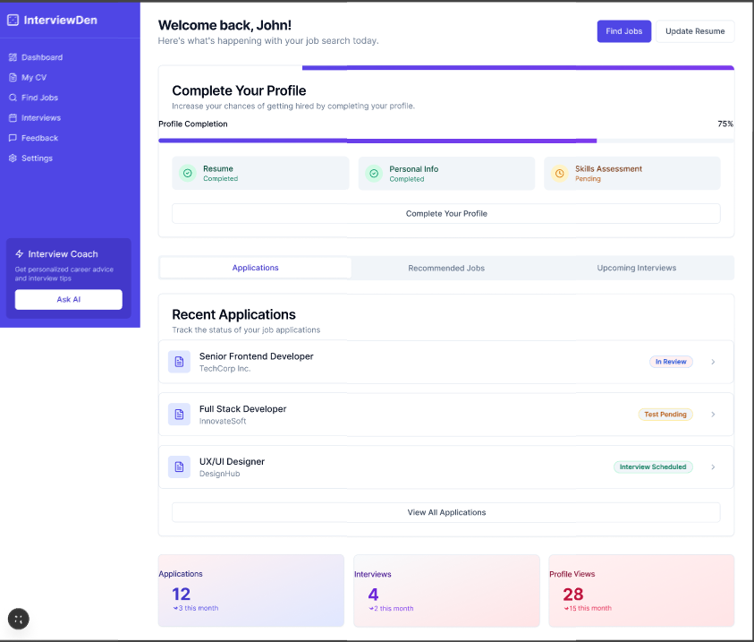
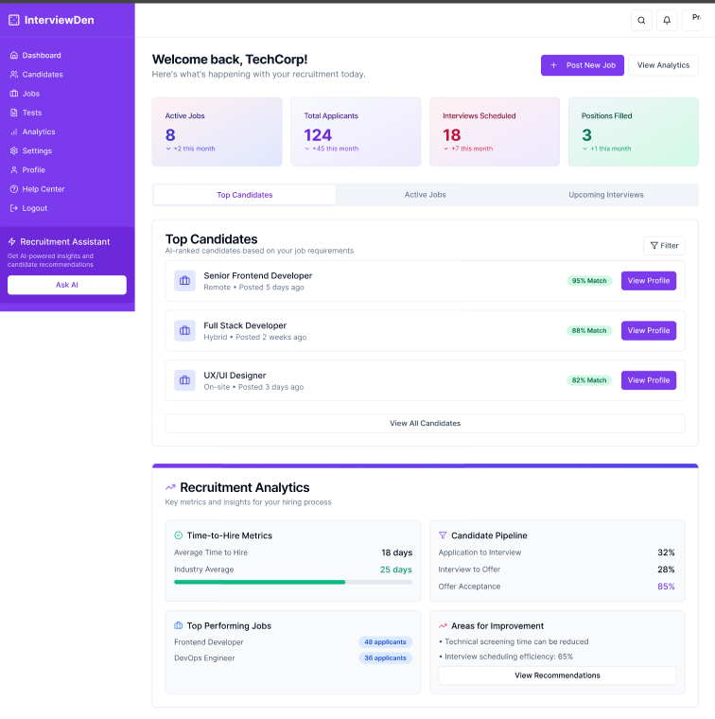
Candidate Portal
Comapany Portal

Slide 19
Thank you!
Any Questions?

Slide 20
References
Reference for Dataset:
Khalil, Y. (2023). Resumes Images Dataset. Kaggle. Retrieved from https://www.kaggle.com/datasets/youssefkhalil/resumes-images-datasets

